Slide 1
San Francisco Airport Runway Use
By: Vichakshan Maturu

Slide 2
Overview
This data set regards the air traffic flow at the SFO airport in San Francisco, California. The data collected is in regards to late night flights, and to see what runways are used the most.
Source of Dataset: https://www.kaggle.com/datasets/thedevastator/san-francisco-airport-runway-use

Slide 3
Describing the Data
Where is it from?
What is in the data?
Attributes
This data was found on Kaggle.com. The data was collected from the City of San Francisco.
This data set studies the air traffic flow at the SFO airport in San Francisco, California. The data collected is in regards to late night flights, and to see what runways are used the most.
The data consists of 4 different runways (01L/R, 10L/R, 19L/R, 28L/R). It also consists of the specified year and month the runways were used, the percentage of total departures by runway, and etc

Slide 4
Why is this an interesting data set? This data enables the analysis of late-night aircraft departures from San Francisco Airport, facilitating the study of runway usage's impact on air and noise pollution in residential areas. By examining the distribution of departures across runways during late-night hours, we can discern the extent to which aircraft utilize specific runways.

Slide 5
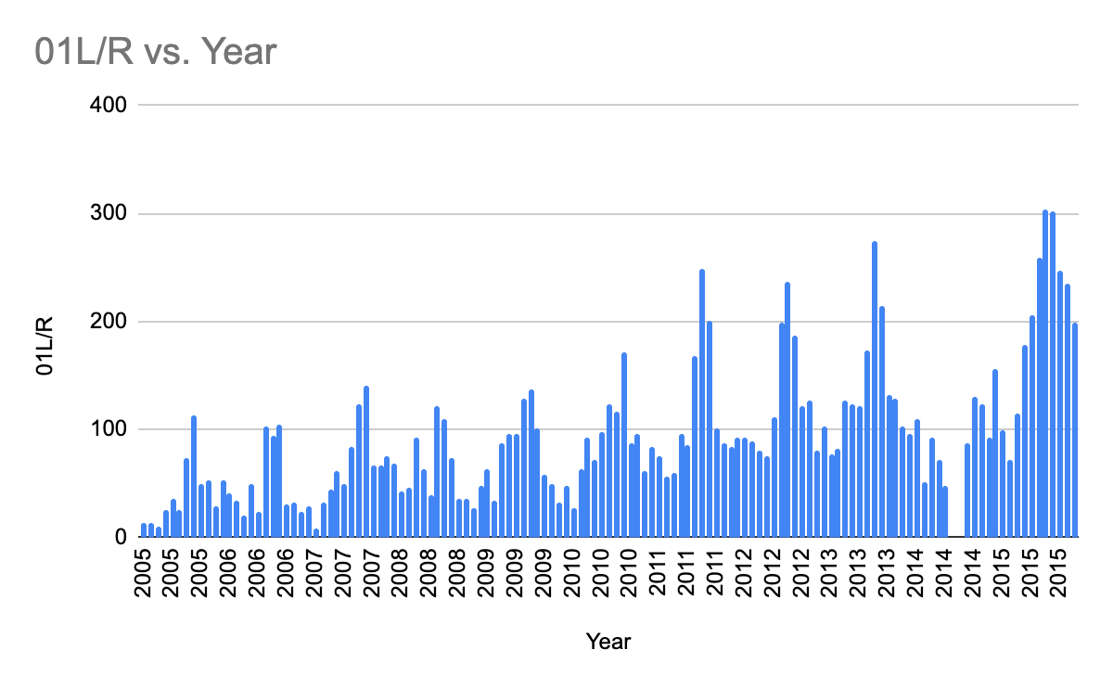
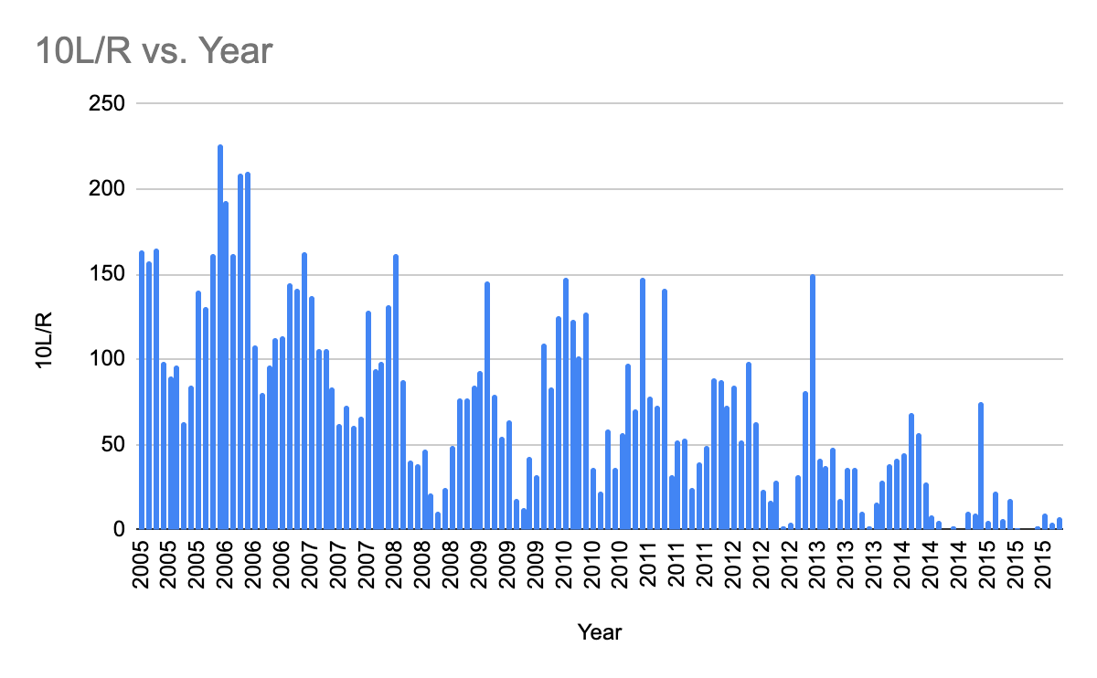
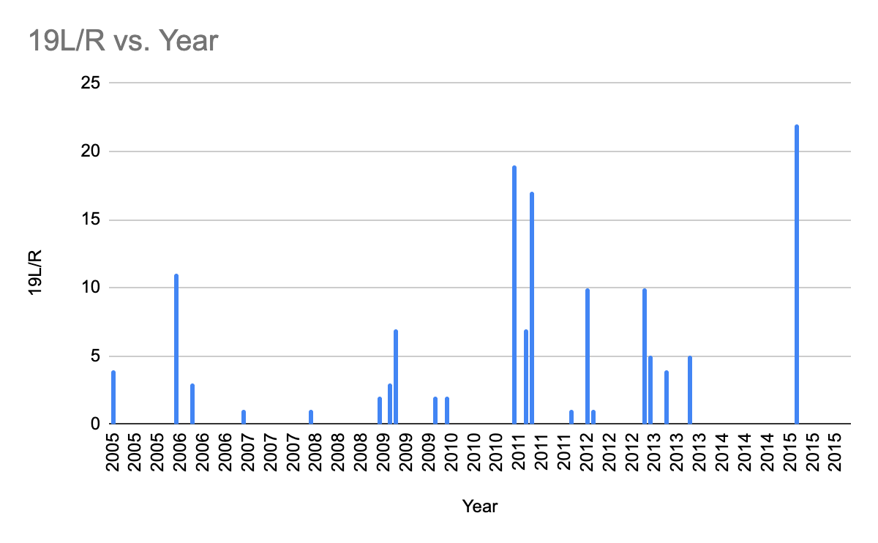
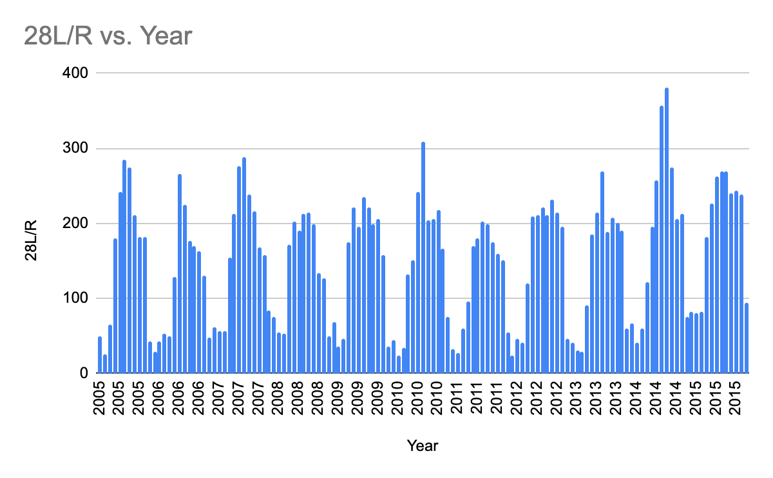
What does the data tell us?
These column charts provide insight into the frequency of runway utilization over a decade. Upon analyzing the charts, it becomes evident that runway 19L/R experienced notably lower usage compared to the remaining runways, with instances of infrequent use. Conversely, runways 01L, 10L, and 28L exhibited frequent and consistent usage patterns.
Observations:
Runway 01L/R ‘s graph seems to be skewed left
Runway 10L/R’s graph seems to be skewed right
Runway 28L/R ‘s graph seems to be symmetric and multimodal.

Slide 6
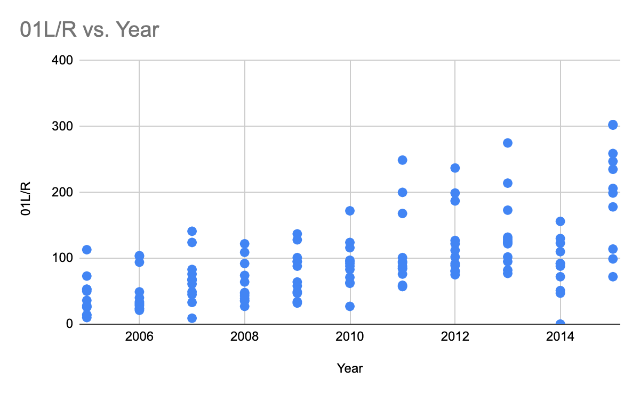
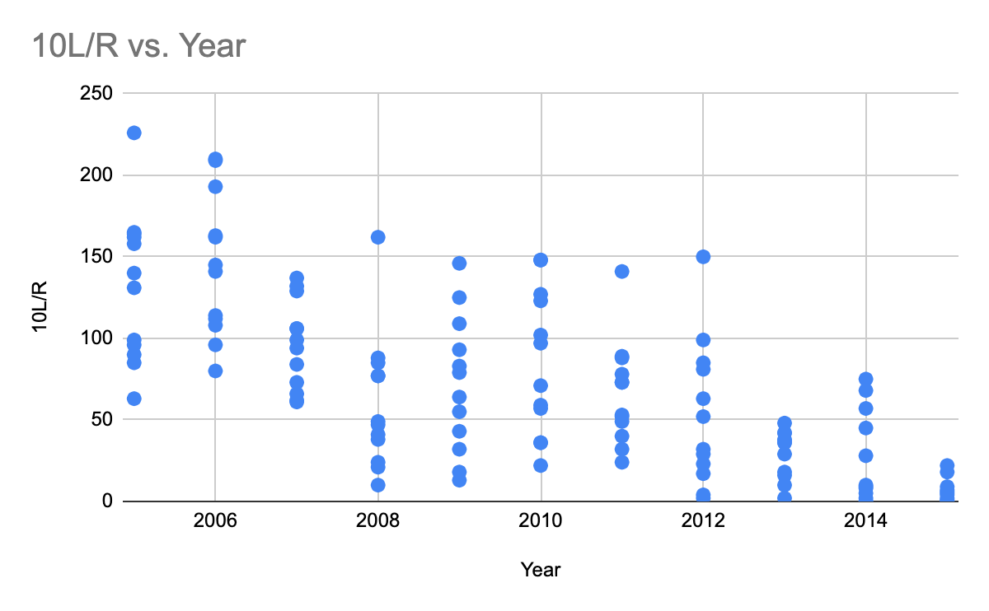
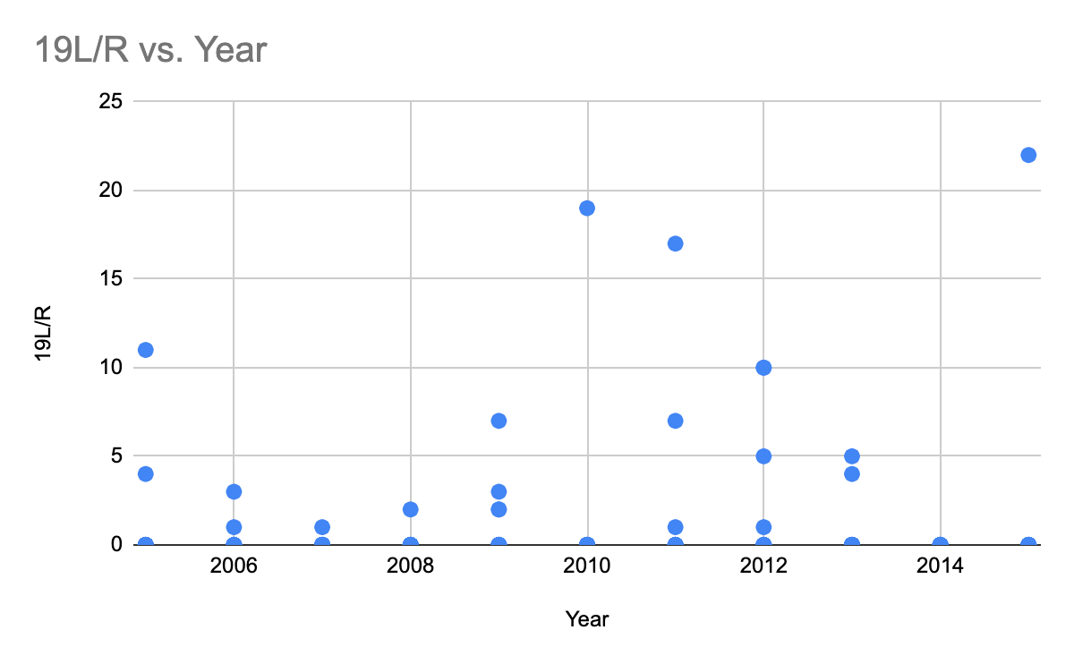
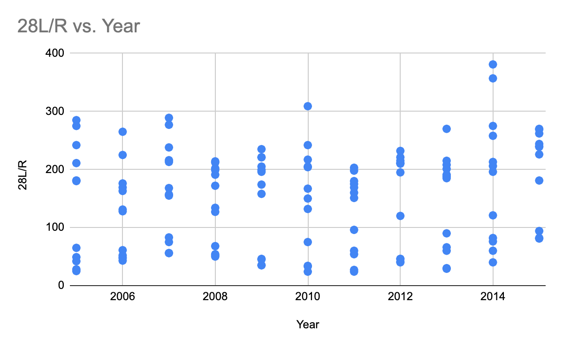
Another graphical way of interpreting the data
In addition to the column charts, scatter plots offer a different perspective on the data by showcasing the annual frequency distribution. We can observe how the usage patterns of each runway fluctuate over the course of each year within the analyzed 10-year timeframe. Patterns of convergence and divergence among the data points can highlight instances of significant runway preference or shifts in utilization strategies over time.

Slide 7
What questions can I answer with this set?
Rather than answer questions, we can use this data set to study and solve various problems such as:
Identity areas of the SFO airport prone to noise pollution from aircraft and develop ways to limit it.
Monitor seasonal trends in aircraft late night departures by runway, in order to inform flight controllers and develop improved flight control regulations and procedures at the SFO airport.

Slide 8
Soundwaves
Sound travels through matter in the form of longitudinal wave motions, because the particles of the medium vibrate back and forth longitudinally in the direction of propagation.
Sound travels at a definite speed. In some substances, sound travels faster(like water is faster than air). These soundwaves can disturb oceanic ecosystems and endanger numerous species of life.
Sound travels through matter in the form of longitudinal wave motions, because the particles of the medium vibrate back and forth longitudinally in the direction of propagation.
Sound travels at a definite speed. In some substances, sound travels faster (like water, than air). These soundwaves can disturb oceanic ecosystems and endanger numerous species of life.
As the sound wave advances, variations in pressure occur at all points in the transmitting medium. The greater the pressure variations, the more intense the sound wave is. Intensity is proportional to the square root of pressure variation regardless of the frequency.
The engine on a modern jetliner, at takeoff thrust, has a sound intensity of 90dB, whereas a 110dB coming from the engine turbine.

Slide 9
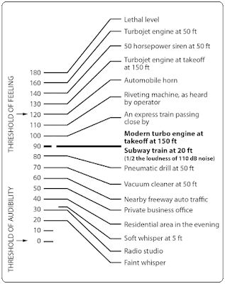
How lethal jet turbines are

Slide 10
Geographical Sound Pollution Affected Areas
These cities and communities, along with others in the broader San Francisco Bay Area, are part of the airport's surrounding region. Due to the airport's close proximity to these areas, its operations can impact them in terms of noise, air quality, and other factors. Noise pollution from aircraft activities is a significant concern for many of these communities, and efforts are often made to mitigate the impact on residents' quality of life. (10 mile/12km radius)
San Bruno
Millbrae
South San Francisco
Burlingame
Daly City
San Mateo

